Slide 1


ALTSCHOOL OF Cybersecurity (BARAKA 2025)
MONTH 2 – WEEK 4

Slide 2
Refresher- Last week
IP Address Fundamentals
  Understanding Internet Protocol v4 (IPV4) and Structure
  Understanding Binary Format in IP addresses
Subnet and IPv4 Addresses
  What is a Subnet?
  Classes of IPv4 Addresses
  Subnet Mask and IPv4 Addresses
  Subnet Mask and Subnetting Techniques
  Classless Inter-Domain Routing (CIDR) Notation and Variable Length Subnet Mask
  Class Demo

Slide 3
Classless Inter-Domain Routing (CIDR) Notation
CIDR (Classless Inter-Domain Routing) is a method used to efficiently allocate IP addresses on a network. CIDR allows network administrators to create subnets by allocating IP addresses based on size and need. This enhances the security, organization, and efficiency of the network.
CIDR also incorporates concepts such as IP addresses, subnetting, and route table management — all of which we will go over in detail. But first, let’s delve into CIDR notation and all its benefits.

Slide 4
Classless Inter-Domain Routing (CIDR) Notation
CIDR notation is a concise method to represent an IP address and its associated network prefix. The core part signifies the network prefix, while the CIDR suffix determines the variation or available addresses.
All IPv4 addresses are 32 bits, which can be broken up into 4 bytes, so the CIDR suffix informs the reader how many bits are already allocated. The full form of CIDR suffix will never be higher than 32 since that would be larger than the IP address itself.

Slide 5
CIDR Notation - SYNTAX
192.168.1.0/24
IP Address: Everything before the slash is the network IP address. All IP addresses will be a variation of the 192.168.1.X, where X is the host.
CIDR Notation: The slash and everything after it is the CIDR notation. The 24 represents the number of bits that are allocated to the IP addresses. Find the difference between 32 and 24 to determine how many bits are available for allocation.
Prefix: The network prefix is 192.168.1. These three octets are reserved and will remain unchanged throughout the IP allocation process.
Host: The host, part of the IP address ("0" in this example), is the section that identifies specific devices within the network. In this case, the last 8 bits (as determined by the "/24" CIDR notation) are available for different hosts on this network, allowing for 256 unique host addresses (2^8 = 256).

Slide 6
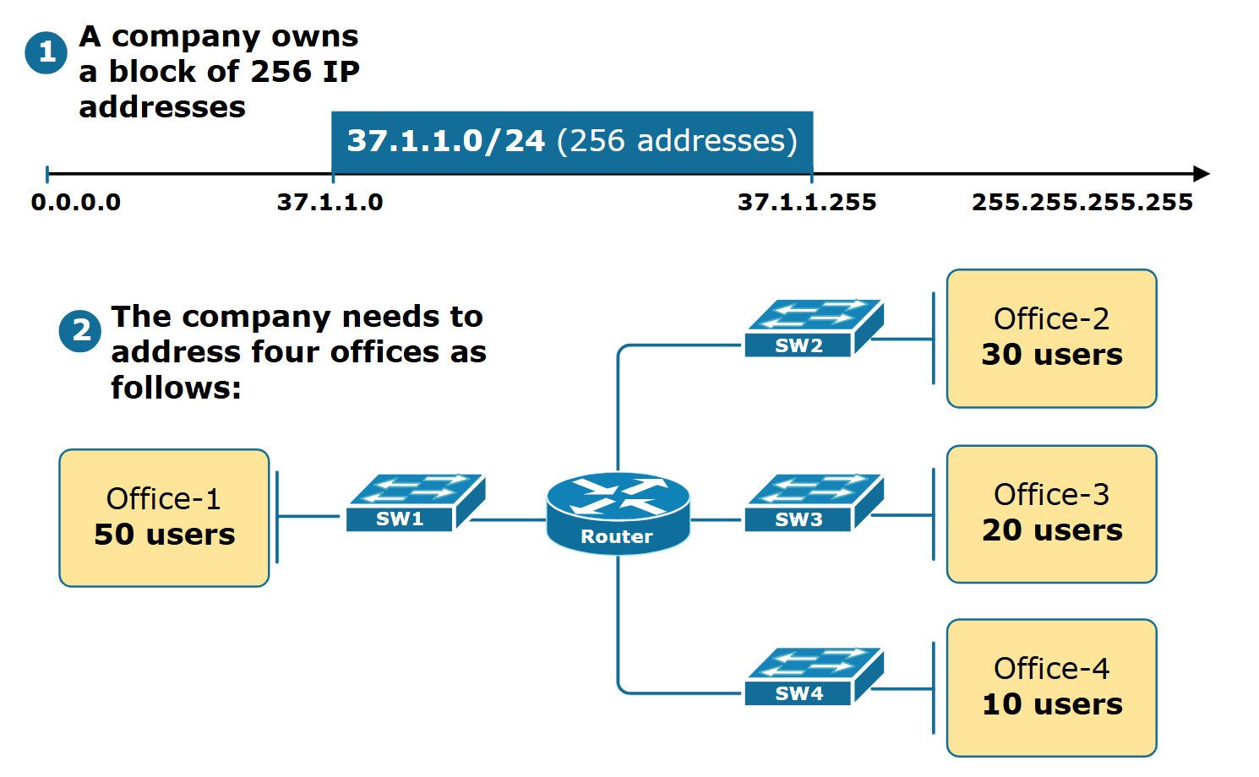
Variable Length Subnet Masking (VLSM)
To understand what Variable Length Subnet Masking (VLSM) is, let's go through a business example. Suppose a company has bought the IP address range 37.1.1.0/24 (256 addresses). The company has 5 offices, as shown in figure 1 below:

Slide 7
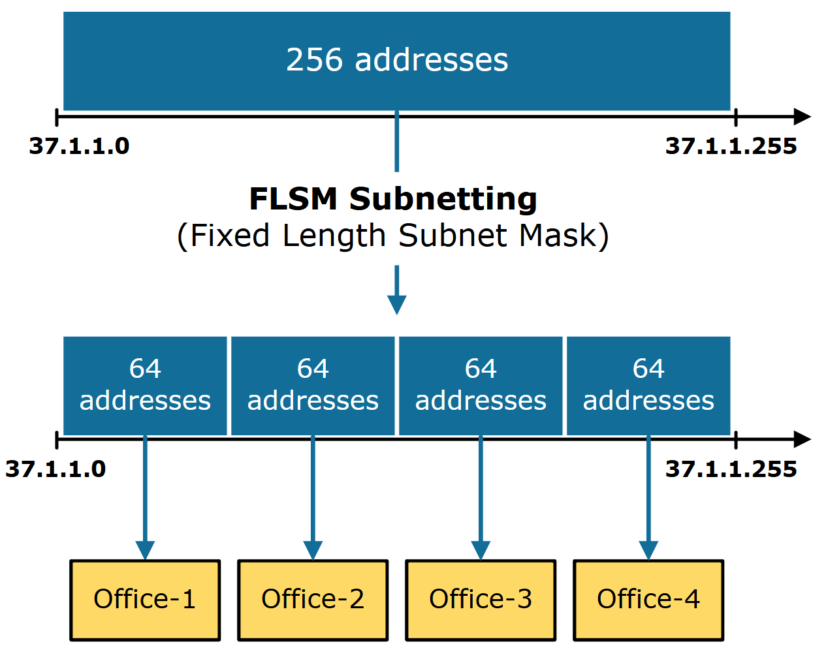
Variable Length Subnet Masking (VLSM)
We are tasked to subnet the 37.1.1.0/24 IP address block and assign each office an IP subnet. Let's see what the two ways to do this are.
The first approach to this task is to divide the 256-address block into four equal-sized subnets. This technique is called Fixed Length Subnet Mask (FLSM). The benefit of this approach is that all subnets have the same subnet mask, which makes the process very straightforward and less prone to errors. Figure 2 below illustrates this example.

Slide 8
Variable Length Subnet Masking (VLSM)
However, this method results in a significant waste of IP addresses. For example, office-4 has only 10 users, but we assign a subnet with 64 IP addresses. Hence, 54 addresses sit unused. From the company's point of view, this is a bad use of resources

Slide 9
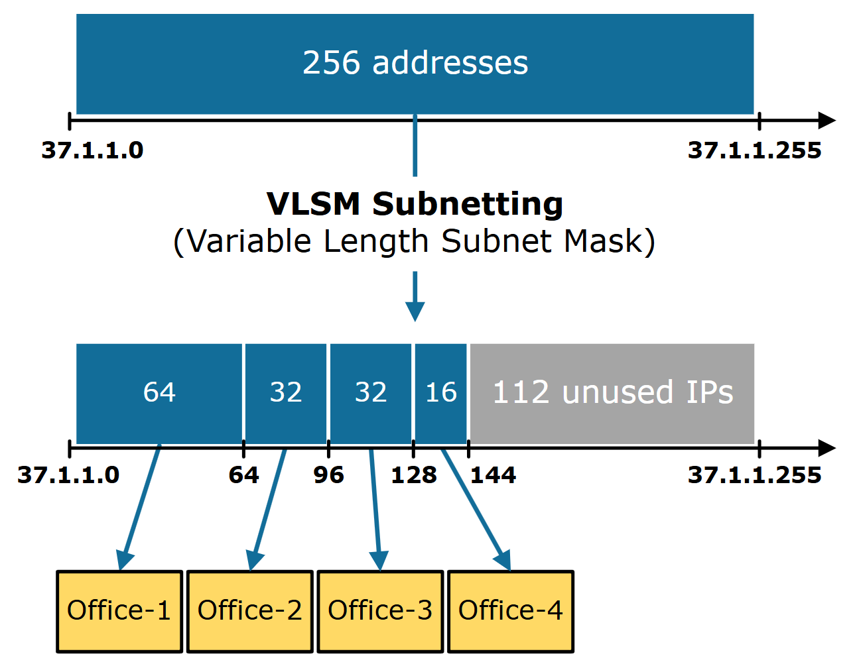
Variable Length Subnet Masking (VLSM)
VLSM stands for Variable Length Subnet Mask. VLSM is a subnetting technique that allows network admins to allocate IP addresses more efficiently using different subnet masks for different network segments. It provides greater flexibility in assigning IP addresses by creating subnets of varying sizes based on the specific needs and number of hosts in each subnet. This technique helps reduce the waste of IP addresses and better uses the available IP space.

Slide 10
MONTH 2 - WEEK 4
Introduction to Network Protocols and Services
  Network Protocols and Services
  Understanding the TCP or IP Protocol Suite
  Introduction to TCP IP protocol suite
  Why TCP IP became the standard and its impact today
Overview of the TCP IP model layers
  TCP IP model layers
  Practical application of the TCP IP model layers
  Understanding UDP –User Datagram Protocol
  Common protocols – HTTP, HTTPS, FTP, DNS, DHCP, SMTP
  Network Port and their use cases

Slide 11
Introduction to Network Protocols and Services
Day 1

Slide 12
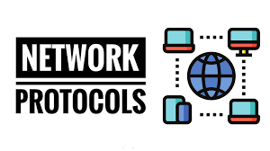
Network protocol
Network protocols are sets of rules that govern communication between devices on a network, ensuring data is exchanged efficiently and accurately. They act as a common language, enabling different devices and software to interact.

Slide 13
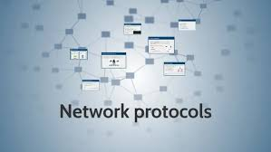
Network Protocol – WHAT THEY DO
Network protocols define how data is formatted, sent, and received across a network. They ensure that information is transmitted and received correctly, regardless of the specific hardware or software being used.

Slide 14
Network Protocol – WHY THEY ARE ESSENTIAL
Protocols are essential for the internet and digital communication as they allow devices to communicate seamlessly. They enable computers to share information, access the web, and use various online service

Slide 15
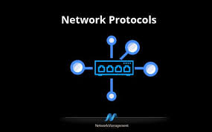
Types of network protocols
Different protocols serve different functions to ensure efficient, quick, and secure network communication. Various types of network protocols can be categorized into the following three broad categories to help organizations operate seamlessly across different business scenarios:

Slide 16
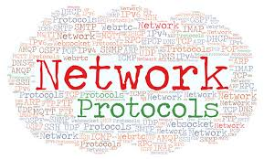
TYPES OF network protocols - Network Communication Protocols
These protocols determine the rules and formats to transfer data across networks. Communication protocols govern various aspects of analog and digital communications, such as syntax, authentication, semantics, and error detection, among others. Some key network communication protocols include:
  Hyper-Text Transfer Protocol (HTTP)
  Transmission Control Protocol (TCP)
  Internet Protocol (IP)
  User Datagram Protocol (UDP)
  File Transfer Protocol (FTP)

Slide 17
TYPES OF network protocols - Network SECURITY Protocols
These protocols ensure safe data transmission over the network connections. Network security protocols define the procedures to secure data from any unauthorized access. These protocols leverage encryption and cryptography to safeguard. Here are the most widely used network security protocols:
  Secure File Transfer Protocol (SFTP)
  Hyper-Text Transfer Protocol Secure (HTTPS)
  Secure Socket Layer (SSL)

Slide 18
TYPES OF network protocols - Network MANAGEMENT Protocols
Network managers require standard policies and procedures to manage and monitor the network for maintaining smooth communication. Network management protocols ensure quick troubleshooting and optimal performance across the network. The following are essential network protocols management:
  Simple Network Management Protocol (SNMP)
  Internet Control Message Protocol (ICMP)

Slide 19
Understanding the TCP or IP Protocol Suite
Day 1

Slide 20
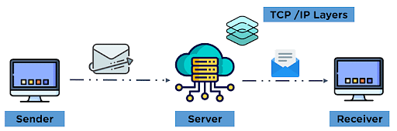
TCP or IP Protocol Suite
The TCP/IP model refers to the Transmission Control Protocol/Internet Protocol Model. This model is a part of the network domain designed specifically for overseeing efficient and error-free transmission of data.
The model works on a four-layered architecture model, where each layer implicit the required network protocols on the data to be transmitted, which remodels the data to the most optimum structure for efficient transmission over the network.

Slide 21
TCP or IP Protocol Suite
The Internet Protocol Suite, or TCP/IP for short, is the set of protocols that make up the network layer of the Internet.
The first version of TCP/IP was ARPANET (1975), which stands for Advanced Research Projects Administration Network. The name changed to TCP/IP in 1983, when it became an open standard that could be used on any network.
To give researchers access to each other's equipment, they needed to send messages quickly over long distances without having them re-transmitted by any intermediate nodes along the way. This necessity led to the development of the Transmission Control Protocol (TCP) and Internet Protocol (IP). These protocols were intended for machine-to-machine connections, such as between computers over local area networks or wide-area networks

Slide 22
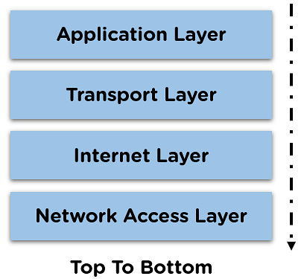
TCP or IP Protocol Suite - FEATURES
The TCP/IP model is among one of the most important network concepts that contributed to the working of ARPANET.
The TCP/IP model comprises four layers: the network access layer, the internet layer, the transport layer, and the application layer (going from bottom to top).
The network model is implemented during network and communication-related issues.
Communication between different modes of network devices is possible through the application of various layers.
The layers in the model provide maintenance of communication channels, flow control, and reliability check format, among other applications in the form of protocols. Simple Network Management Protocol (SNMP)

Slide 23
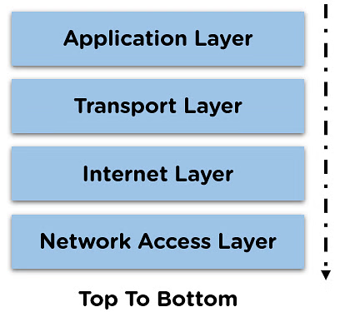
TCP or IP Protocol Suite - FEATURES
Each layer performs a specific task on the data that is being transmitted over the network channel, and data moves from one layer to another in a preset pattern.
The TCP model represents the flow of data when it is being transmitted from the sender side. In the case of data being received, the layers of the model work in reverse order.

Slide 24
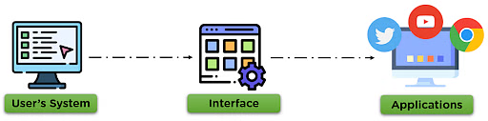
TCP or IP Protocol Suite – APPLICATION LAYER
This is the topmost layer which indicates the applications and programs that utilize the TCP/IP model for communicating with the user through applications and various tasks performed by the layer, including data representation for the applications executed by the user and forwards it to the transport layer.
The application layer maintains a smooth connection between the application and user for data exchange and offers various features as remote handling of the system, e-mail services, etc.

Slide 25

TCP or IP Protocol Suite – APPLICATION LAYER
Some of the protocols used in this layer are:
HTTP: Hypertext transfer protocol is used for accessing the information available on the internet.
SMTP: Simple mail transfer protocol, assigned the task of handling e-mail-related steps and issues.
FTP: This is the standard protocol that oversees the transfer of files over the network channel.

Slide 26
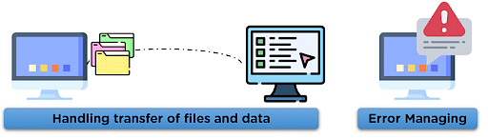
TCP or IP Protocol Suite - Transport Layer
This layer is responsible for establishing the connection between the sender and the receiver device and also performs the task of dividing the data from the application layer into packets, which are then used to create sequences.
It also performs the task of maintaining the data, i.e., to be transmitted without error, and controls the data flow rate over the communication channel for smooth transmission of data.

Slide 27
TCP or IP Protocol Suite - Transport Layer
The protocols used in this layer are:
TCP: Transmission Control Protocol is responsible for the proper transmission of segments over the communication channel. It also establishes a network connection between the source and destination system.
UDP: User Datagram Protocol is responsible for identifying errors, and other tasks during the transmission of information. UDP maintains various fields for data transmission such as:
Source Port Address: This port is responsible for designing the application that makes up the message to be transmitted.
Destination Port Address: This port receives the message sent from the sender side.
Total Length: The total number of bytes of the user datagram.
Checksum: Used for error detection of the message at the destination side.

Slide 28
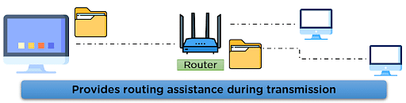
TCP or IP Protocol Suite - INTERNET Layer
The Internet layer performs the task of controlling the transmission of the data over the network modes and enacts protocols related to the various steps related to the transmission of data over the channel, which is in the form of packets sent by the previous layer.
This layer performs many important functions in the TCP/IP model, some of which are:
It is responsible for specifying the path that the data packets will use for transmission.
This layer is responsible for providing IP addresses to the system for the identification matters over the network channel.

Slide 29
TCP or IP Protocol Suite - INTERNET Layer
Some of the protocols applied in this layer are:
IP: This protocol assigns your device with a unique address; the IP address is also responsible for routing the data over the communication channel.
ARP: This protocol refers to the Address Resolution Protocol that is responsible for finding the physical address using the IP address.

Slide 30
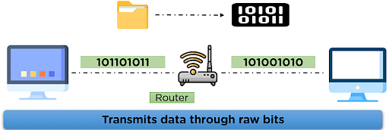
TCP or IP Protocol Suite - Network Access Layer
This layer is the combination of data-link and physical layer, where it is responsible for maintaining the task of sending and receiving data in raw bits, i.e., in binary format over the physical communication modes in the network channel.
It uses the physical address of the system for mapping the path of transmission over the network channel.

Slide 31
Understanding the TCP or IP Protocol Suite
Day 1

Slide 32
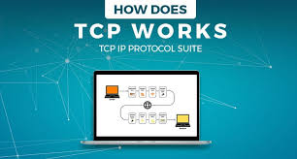
How Does TCP/IP Work?
The TCP/IP protocol suite is the set of communication protocols used to connect hosts on the Internet. TCP/IP allows computers on the same network to identify and communicate with each other. TCP/IP is a two-layer protocol, with the transport layer (TCP) responsible for reliable end-to-end communication and the Internet layer (IP) accountable for routing packets from the host to the host

Slide 33
How Does TCP/IP Work?
At the transport layer, TCP provides a reliable byte-stream service to applications. TCP guarantees the delivery of data and that data will be delivered in the same order in which it was sent. TCP uses several mechanisms to provide this service, including sequence numbers, acknowledgments, and timeouts.
At the Internet layer, IP is responsible for routing datagrams (packets) from host to host. IP does not guarantee the delivery of datagrams, but it tries to deliver them as best. If a datagram cannot be delivered, IP will return an error message to the source host.
The TCP/IP protocol suite is the most commonly used protocol suite on the Internet today, and it is also the protocol suite used by most LANs and WANs.

Slide 34
REFRESHER – LAST CLASS
Introduction to Network Protocols and Services
  Network Protocols and Services
  Understanding the TCP or IP Protocol Suite
  Introduction to TCP IP protocol suite
  Why TCP IP became the standard and its impact today

Slide 35
MONTH 2 - WEEK 4 (DAY 2)
  Why TCP IP became the standard and its impact today (CONTD)
Overview of the TCP IP model layers
  TCP IP model layers
  Practical application of the TCP IP model layers
  Understanding UDP –User Datagram Protocol
  Common protocols – HTTP, HTTPS, FTP, DNS, DHCP, SMTP
  Network Port and their use cases

Slide 36
Why TCP IP became the standard and its impact today
Day 2

Slide 37
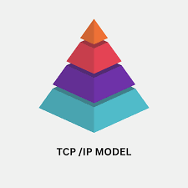
TCP/IP - its impact today
TCP/IP became the standard for internet communication due to its simplicity, flexibility, and robust design, which enabled it to overcome the limitations of other protocols and ensure reliable data transfer across various networks.
Ubiquitous Use: TCP/IP is used by billions of devices and millions of applications, making it an indispensable part of modern communication.
Underlying Infrastructure: TCP/IP is the underlying infrastructure for various internet services, including email, web browsing, file transfer, and video streaming.
Inter-Network Communication: TCP/IP enables devices on different networks to communicate seamlessly, fostering global connectivity.
Evolution and Adaptation: TCP/IP has continued to evolve and adapt to new technologies, including IPv6 and emerging network architectures.

Slide 38
Why TCP/IP Became the Standard:
Simplicity and Scalability: TCP/IP's design was intentionally made simple and scalable, allowing for easy adaptation to various network environments and technologies.
Reliability and Error Handling: TCP/IP provides mechanisms for ensuring reliable data delivery, including error detection and retransmission of lost packets.
Open and Non-Proprietary: Being open and non-proprietary, TCP/IP allows for easy modification, development, and implementation by various organizations and individuals.
Interoperability: TCP/IP promotes interoperability between different vendors' equipment, ensuring that devices from different manufacturers can communicate seamlessly.
No Strong Competition: When TCP/IP was first introduced, it lacked strong competitors, allowing it to establish itself as the dominant protocol suite.

Slide 39
Why TCP/IP Became the Standard:
Government Support: The US Department of Defense's adoption of TCP/IP as a standard for military networks further solidified its position as the leading protocol.
Gradual Transition: The transition from ARPANET to TCP/IP was gradual and well-planned, minimizing disruptions and allowing for a smooth adoption.

Slide 40
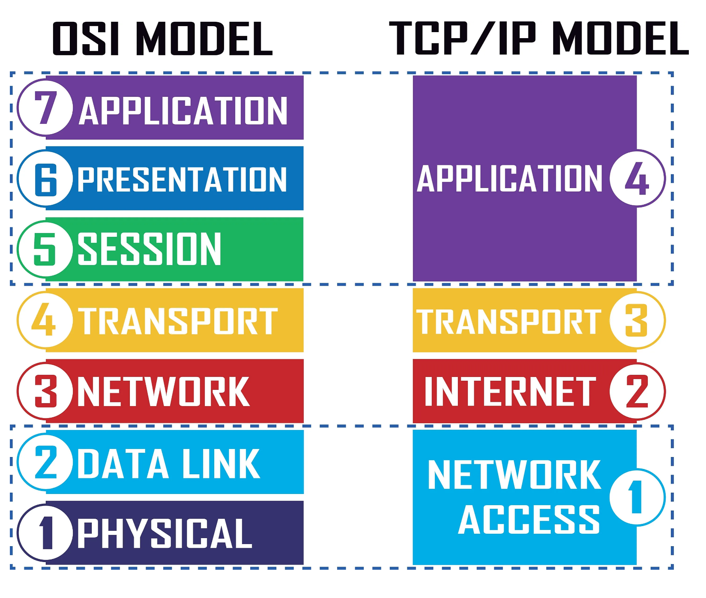
TCP/IP VS OSI

Slide 41
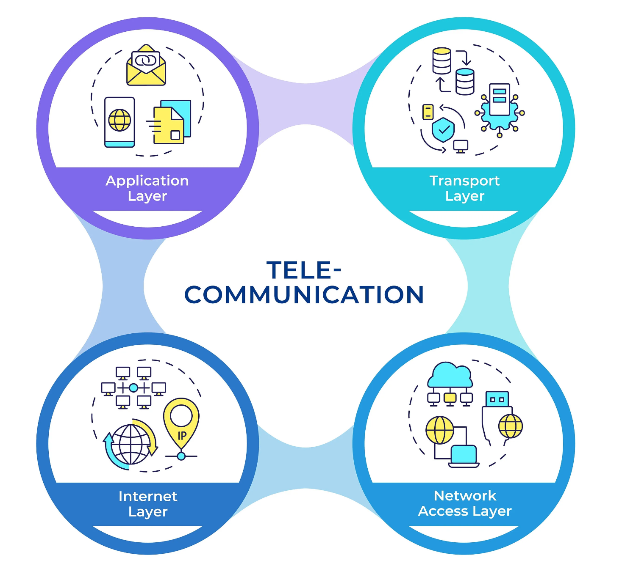
Data transmission in TCP/IP networks
In the TCP/IP communication, data is transmitted using data packets. These packets carry information between the sender and the receiver. A data packet consists of three main components: the header, the payload and the footer.
Header: Contains metadata, including source and destination addresses, sequence numbers and protocol information. This ensures packets are delivered to the right location and in the correct order.
Payload: That is the actual content of the packet, such as text, images or files, being transmitted from the sender to the recipient.
Footer: Also known as the trailer, this optional component helps verify data integrity during transmission. If packets are incomplete or corrupted, TCP requests retransmission.

Slide 42
Data transmission in TCP/IP networks
During communication, the Transport Layer divides data into packets and assigns sequence numbers to them.
The Internet Layer adds addressing and routing information, ensuring packets navigate networks independently.
The data packets travel independently along different paths across the internet, ensuring a reliable and fault-tolerant transmission.
On arrival in the TC/IP application layer, the receiving device reassembles the packets into the original data.

Slide 43
TCP/IP – BUSINESS CASE
TCP and IP form the foundation for numerous business-critical applications and network solutions in companies. It allows reliable communication between devices and supports a variety of technologies that define the modern work environment.
VPNs and Remote Access: One of the most common applications of the TCP/IP model in businesses is Virtual Private Networks (VPNs). Employees can securely access the company network even when working remotely. TCP/IP protocols and standards ensure the reliable transmission of data packets while protecting them from unauthorized access.
Firewalls and security solutions: The model also supports the use of firewalls in corporate networks, which filter network traffic based on TCP/IP data, identifying and blocking potential threats.
IT management and network infrastructure: Network administrators can use TCP/IP protocols like SNMP (Simple Network Management Protocol) or ICMP (Internet Control Message Protocol) to monitor device status and detect issues early.
Communication and data transfer: Business applications such as emails, web conferencing or file transfers rely on protocols built on the TCP/IP model. It ensures these services operate reliably and efficiently.

Slide 44
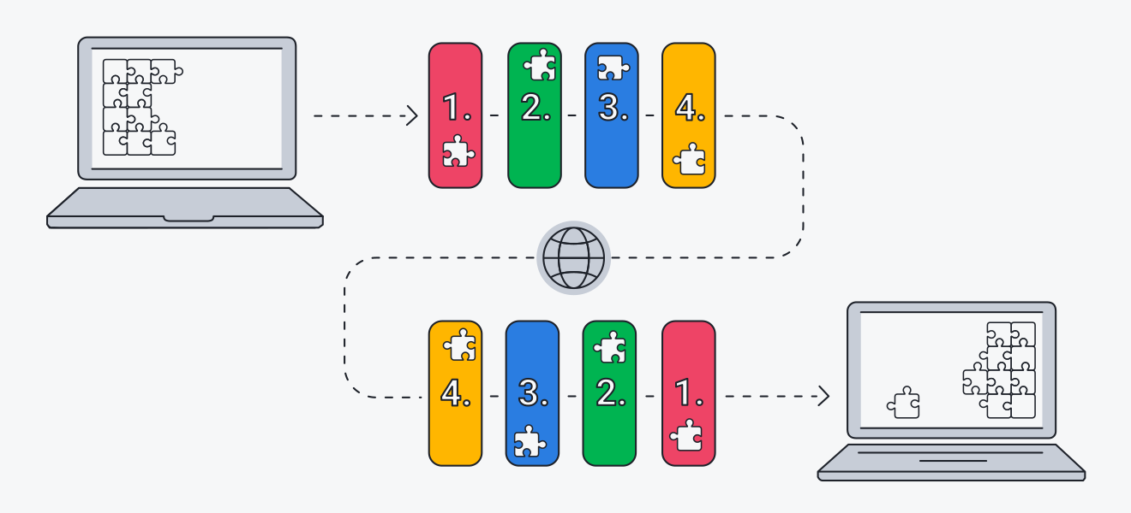
TCP/IP – PRACTICAL FLOW
Whenever you send something over the internet — a message, a photo, a file — the TCP/IP model divides that data into packets according to a four-layer procedure. The data first goes through these layers in one order, and then in reverse order as the data is reassembled on the receiving end.
The TCP/IP model works because the whole process is standardized. Without standardization, communication would go haywire and slow things down — and fast internet service relies on efficiency. As the global standard, the TCP/IP model is one of the most efficient ways to transfer data over the internet.

Slide 45
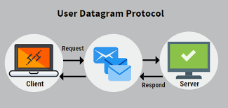
UDP (User Datagram Protocol)
User Datagram Protocol (UDP) is a communications protocol for time-sensitive applications like gaming, playing videos, or Domain Name System (DNS) lookups. UDP results in speedier communication because it does not spend time forming a firm connection with the destination before transferring the data. Because establishing the connection takes time, eliminating this step results in faster data transfer speeds.
However, UDP can also cause data packets to get lost as they go from the source to the destination. It can also make it relatively easy for a hacker to execute a distributed denial-of-service (DDoS) attack.

Slide 46
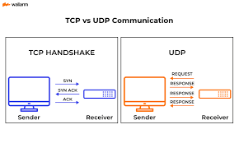
UDP (User Datagram Protocol)
In many cases, particularly with Transmission Control Protocol (TCP), when data is transferred across the internet, it not only has to be sent from the destination but also the receiving end has to signal that it is ready for the data to arrive. Once both of these aspects of the communication are fulfilled, the transmission can begin. However, with UDP, the data is sent before a connection has been firmly established. This can result in problems with the data transfer, and it also presents an opportunity for hackers who seek to execute DDoS attacks.

Slide 47
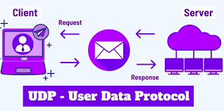
HOW UDP WORKS
In comparison to other networking protocols, the process behind UDP is fairly simple. A target computer is identified and the data packets, called “datagrams,” are sent to it. There is nothing in place to indicate the order in which the packets should arrive. There is also no process for checking if the datagrams reached the destination.
Even though UDP comes with checksums, which are meant to ensure the integrity of the data, and port numbers, which help differentiate the role the data plays at the source and destination, the lack of an obligatory handshake presents a problem. The program the user is executing with the help of UDP is left exposed to unreliable facets of the underlying network.

Slide 48
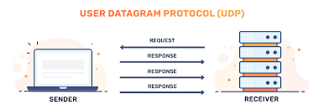
HOW UDP WORKS
As a result, the data may get delivered, and it may not. In addition, the order in which it arrives is not controlled, as it is in TCP, so the way the data appears at the final destination may be glitchy, out of order, or have blank spots.
However, in a situation where there is no need to check for errors or correct the data that has been sent, this may not pose a significant problem. This is one reason why UDP is used in video applications. Getting the video signal to its destination on time is worth the occasional glitches.

Slide 49
TCP VS UPD
As data is transferred from one point to another, it is given a header, which tells devices what to do with it. The UDP header is a simple 8-byte fixed header. With TCP, on the other hand, the header can vary from 20 to 60 bytes. The fields for UDP port numbers are 16 bits long, giving them a range that goes from 0 up to 65535. The header consists of a 16-bit source port, a 16-bit destination port, a 16-bit length, and a 16-bit checksum. This is the information used to send the datagram toward its destination. The sending process does not involve any verification of a connection between the source and the destination.
TCP is different in that it requires a handshake between where the data originates and where it is headed. This makes TCP more reliable than UDP. In the course of a TCP communication, the data can only be sent along after the destination and source have been formally linked. With UDP, because no link is required, the data can be sent right away.

Slide 50
TCP VS UPD
Another difference between TCP and UDP communications is that with TCP, the order in which the packets need to be received is confirmed before the transmission begins. Also, TCP provides for the confirmation that the packets arrived as intended. In the event that the packet does not arrive, TCP dictates that it needs to be sent again. UDP does not require any confirmation, checking, or resending.
If an application uses UDP, the users assume the risk of errors, the data not reaching its destination, or being duplicated. The reward for accepting this trade-off is better speed. UDP itself is not necessarily to blame for the data loss. The information in the header is sufficient to get the data where it needs to go, and the chronological order of the sending of the datagrams should keep them in order.

Slide 51
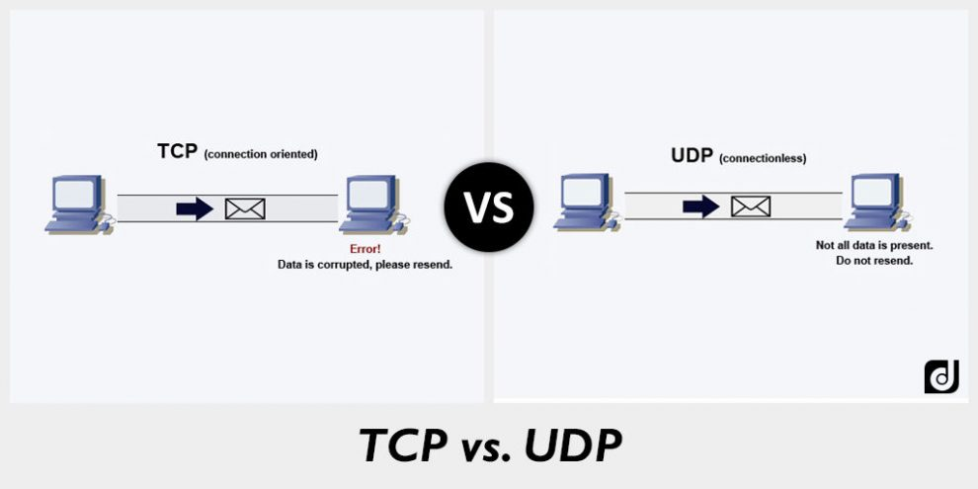
TCP VS UPD

Slide 52
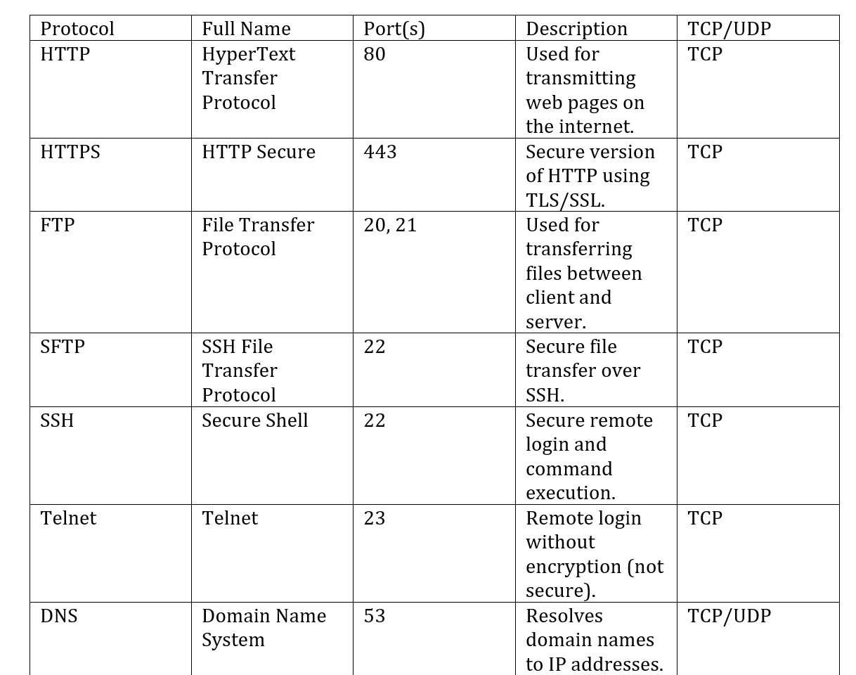
COMMON PROTOCOL AND USE CASE

Slide 53
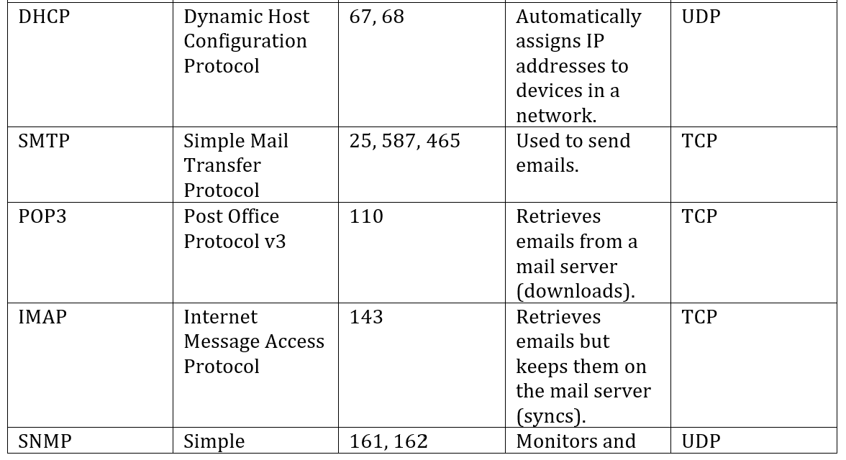
COMMON PROTOCOL AND USE CASE

Slide 54
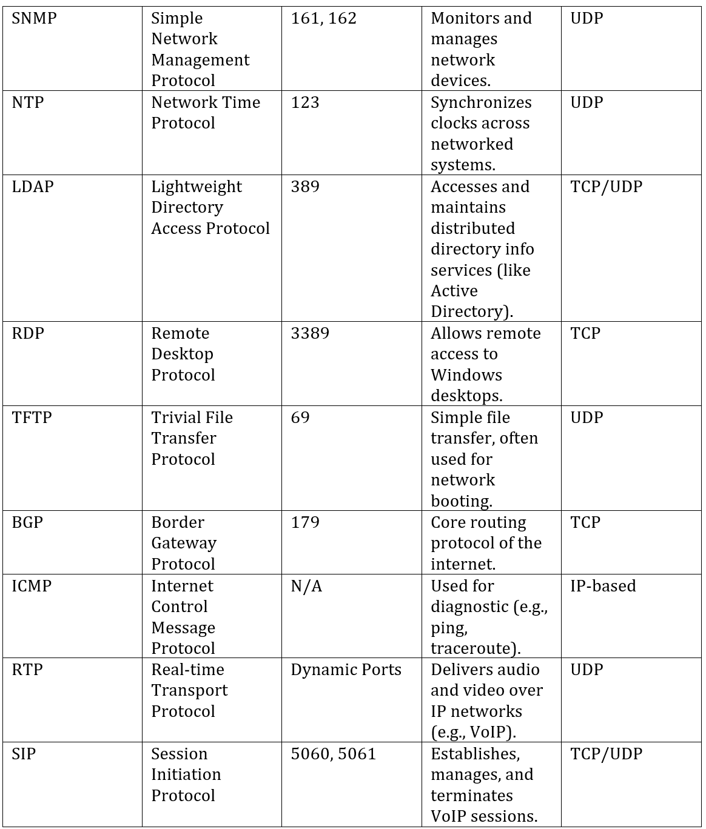
COMMON PROTOCOL AND USE CASE

